Slide 1
Monolithic Applications versus Microservices

Slide 2
Module Outline
Objectives
On completing this module, you will be able to:
Define a monolithic application
Define a microservice and microservices architecture
Compare monolithic architecture with microservices architecture for enterprise solution development
Topics
Monolithic Application
Microservices and Microservices Architecture

Slide 3
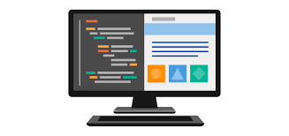
Monolithic Application Architecture
Function 1
Function 2
Function 3
User Interface
Database
Function …
Server
Notes:
The 3-tier architecture is analogous to the MVC design pattern (cf. https://en.wikipedia.org/wiki/Model%E2%80%93view%E2%80%93controller):
DB is the model (defining all the data), UI is the view (providing user interfaces), the server/app is the control (containing all business logics).

Slide 4
Monolithic Enterprise Application Architecture
In the past, an enterprise application is usually built as a single unit with a single executable
It usually comprises three main parts
Client-side User Interface (e.g., HTML pages and javascript running on the browser)
A database (consisting many tables covering multiple entities)
Server-side application that handles:
The HTTP requests,
Executes business logic,
Retrieve and update data from the database,
Select and populate HTML view to be sent to the browser,
…
The server-side application is usually deployed as a single package, referred to as a monolithic application or monolith

Slide 5
Some Characteristics of a Monolith
Has a single code base implementing all functions needed for various business processes (e.g., one big archive file (with .war or .ear suffix) for a Java enterprise application; one folder containing various subfolders and many files for a PHP web application)
Typically, the entire application is developed in one programming language (e.g., C++, Java, Python, or PHP) on one platform (e.g., Windows, Linux, or macOS)
Easier for different parts of the application to be compatible
Less flexibility for the choices of technologies
Less suitable for heterogeneous environments
Over the years, the single code base may become large and complex, difficult to understand and maintain
Different parts of the application have too many interactions and dependencies, even though the code may be modularized
Deployment of a monolith is often either all or none
Not easy to deploy only a part of the application due to dependencies
A change to one function often requires redeploying the entire application package
Scaling only a specific function is not possible, the entire application has to be scaled
Notes:
"Scaling" refers to adding/removing computing resources (e.g., more memory, more CPUs, more individual machines) to/from a system so that the system is able to handle different amount of workloads efficiently and effectively. Cf. https://en.wikipedia.org/wiki/Scalability
Q: how suitable is a monolith for the two challenges faced by enterprise solutions mentioned earlier? What may be the problem(s)? What may be the alternatives?

Slide 6
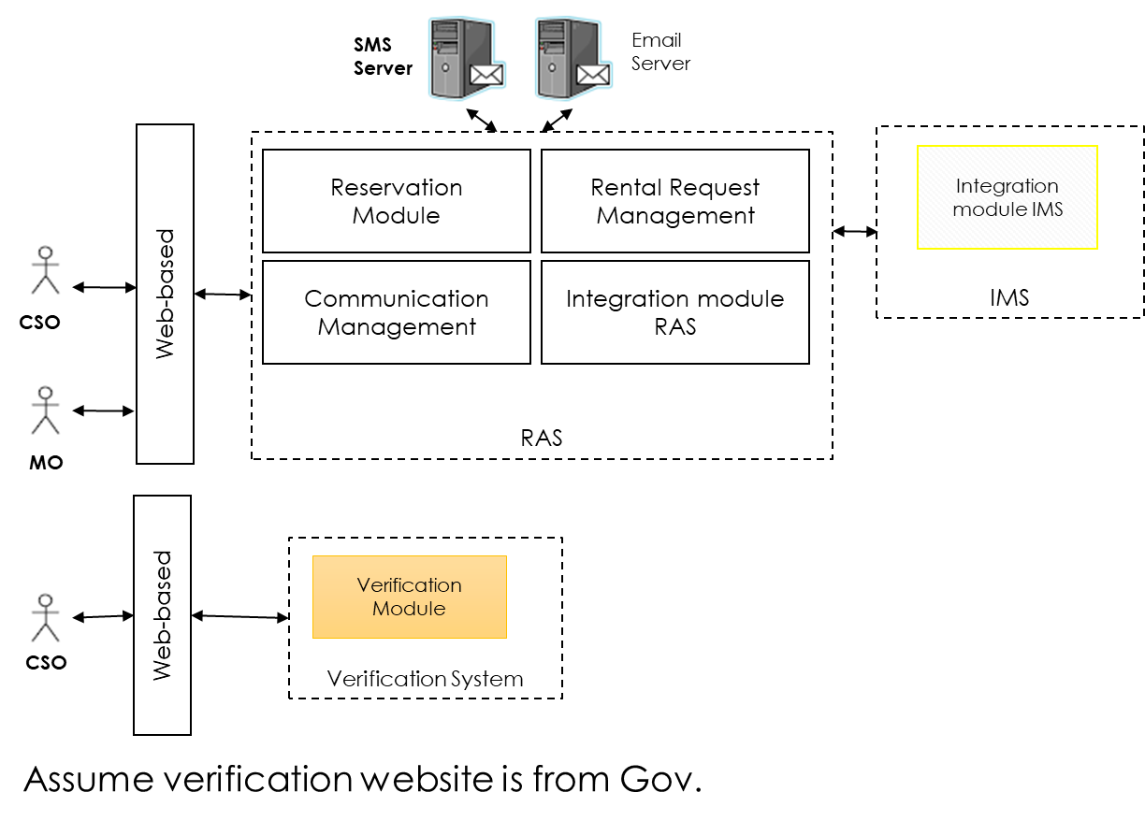
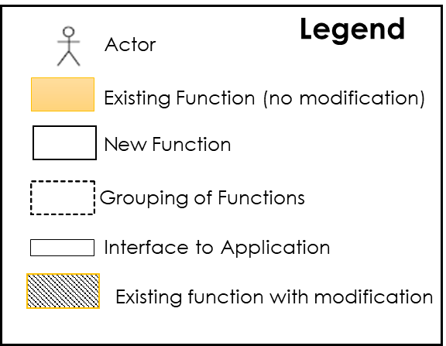
Sample Monolith: Star Mall Solution Overview

Slide 7
Microservices Architecture

Slide 8
Microservices Architecture
Database 1
Function 1
Microservice A
Function 2
Database 2
Function 3
User Interface
Microservice B
Function …
Microservice …
Notes:
Microservices Architecture may also be written as Microservice Architecture in practice, abbreviated as MSA. It's more about the architecture when many microservices come together to form an enterprise solution, less about the architecture of individual microservices (which would be similar to the architecture of a monolithic application but at a small scale).
Understanding of the pros and cons of MSA is an important part of ESD; its discussion will continue throughout the course.

Slide 9
Microservices Architecture
Database 1
Function 1
Interface 1 for User 1
Microservice A
Function 2
Database 2
Function 3
Microservice B
Interface … for User X
Function …
Microservice …
Notes:
The UIs may be decomposed into "micro-UIs" too.

Slide 10
Microservices
A microservice may be defined as a single unit that implements only one or a few (instead of many) functionality needed to support business requirements and can be used by other applications (or microservices) over the network in a standard interface that is independent of programming languages and platforms
Microservices are "loosely coupled" with each other
It can be implemented in a programming language of its own;
E.g., one microservice is implemented in Java; the other in Python;
It can be deployed and run on a platform of its own;
E.g., one microservice runs on Windows; the other on Linux;
It usually has its own data store when a data store is needed;
E.g., an Order microservice has its own database with an Order table; a Customer microservice has its own database with a Customer table
It can be scaled independently
E.g., instances of the same microservice that is more frequently used than others can be deployed to many machines to support concurrent processing
Its implementation can be changed independently, as long as its interface for invocation remains the same
Notes:
Note: "own data store" doesn't necessarily mean separate instances of supporting database software. E.g., the Order database and the Customer database can be in the same instance of the MySQL software running on the same machine. But separating them into different software will have the benefit that different microservices can use different database implementations (so called "polyglot persistence architecture") and easier to scale them independently from each other. Cf. https://plainoldobjects.com/2015/09/02/does-each-microservice-really-need-its-own-database-2/
Whether a microservice really needs its own database or own database software, it depends on how much independence among the microservices we (as the solution designer) want.

Slide 11
Some Characteristics of Microservices
Microservices architecture is a style or pattern, not rigorous rules
Each microservice is relatively small and simple in comparison with usual enterprise applications
A microservice can be developed and managed by a small agile team independently
Each development team can manage one or a few microservices
Microservices exchange data with each other through a standard interface by using commonly used data formats and communication technologies
E.g. JSON over HTTP transport; messaging
Microservices architecture promotes a methodology that develops an enterprise application or solution as an assembly of loosely-coupled microservices
Notes:
Assemblies are often guided by business processes of an enterprise.

Slide 12
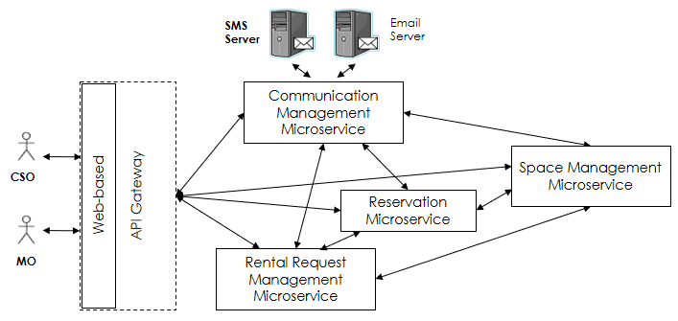
Sample Microservices Architecture for Star Mall

Slide 13
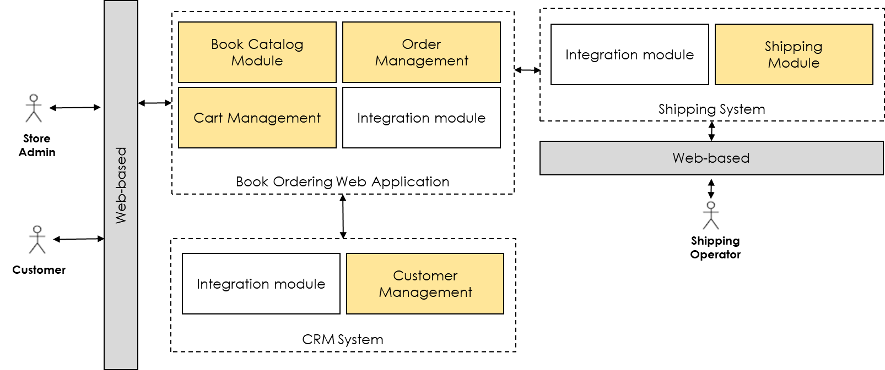
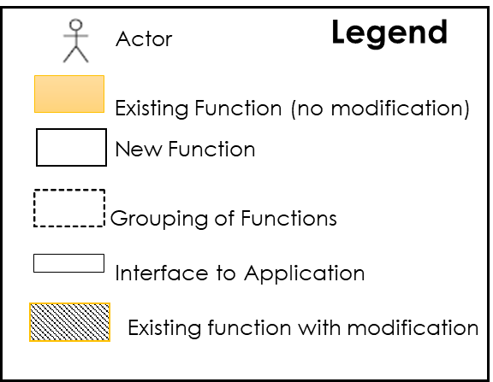
Sample Monolithic Bookstore Solution Overview

Slide 14
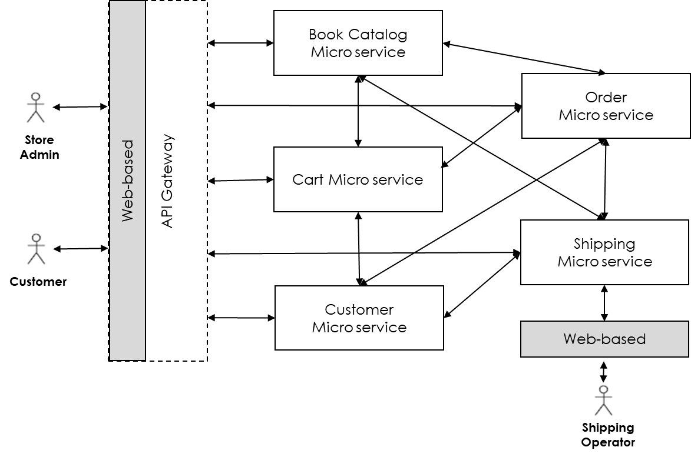
Sample Microservices Architecture for A Bookstore
Notes:
We'll design & implement a simple version of this bookstore in this term

